Slide 1
Large Language Model

Slide 2
Agenda
Seq2Seq models recap
Transformers
Attention mechanism
BERT
Large Language Models
ChatGPT

Slide 3
Natural Language Processing

Slide 4
Natural Language Processing (NLP) is a field of Artificial Intelligence (AI) that makes human language intelligible to machines.
NLP combines the power of linguistics and computer science to study the rules and structure of language, and create intelligent systems capable of understanding, analyzing, and extracting meaning from text and speech.

Slide 5
NLP tasks
Text classification
Food was awesome, and the waiter was very responsive
Discriminative tasks
Positive
Text → ?
Intent classification
I want to book a flight from Canada to the USA, but my card was declined
Intent to book a flight

Slide 6
NLP tasks
Entity Extraction
I want to book a flight from Canada to the USA, but my card was declined
Discriminative tasks
Canada, USA
Text → ?

Slide 7

NLP tasks
Auto-completion
The truth is
I don’t have a lot of creative advice to give
Generative tasks
? → Text
Caption Generation
Photo of a dog at the beach

Slide 8
NLP tasks
Machine Translation
I bought a sweet persimmon in the store
Ich kaufte eine sube persimone im laden
Seq2Seq tasks
Text → Text
Text summarization
The ancient magician chanted the mystical words, and the rabbit vanished into thin air
A magician uses magic to make a rabbit disappear

Slide 9
Timeline
Task specific approaches
Word2vec
(2013)
RNN (1997, 2014)
BPE
(1994, 2016)
Attention (2015)
Transformers
(2017)
BERT (2018)
GPT3
(2020)

Slide 10
Sequence to Sequence models

Slide 11
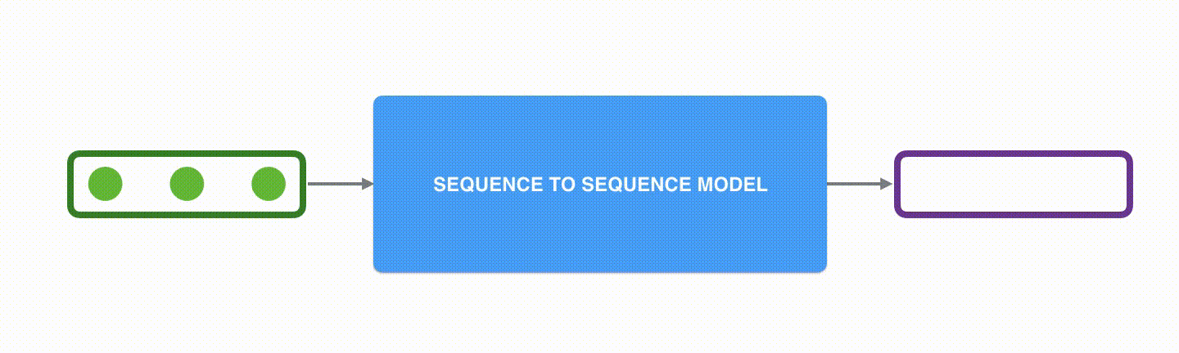
Sequence to sequence models
A sequence-to-sequence model is a model that takes a sequence of items (words, letters, features of an images…etc) and outputs another sequence of items. A trained model would work like this

Slide 12
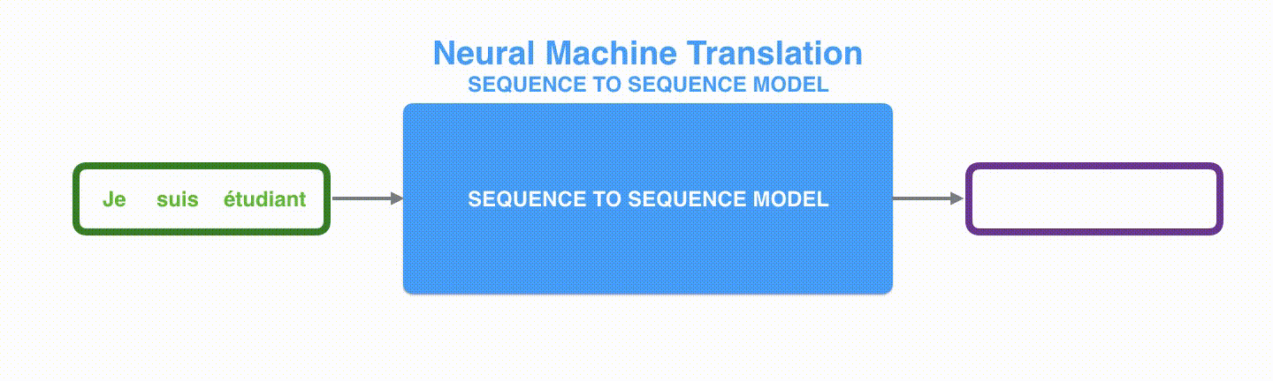
Sequence to sequence models

Slide 13
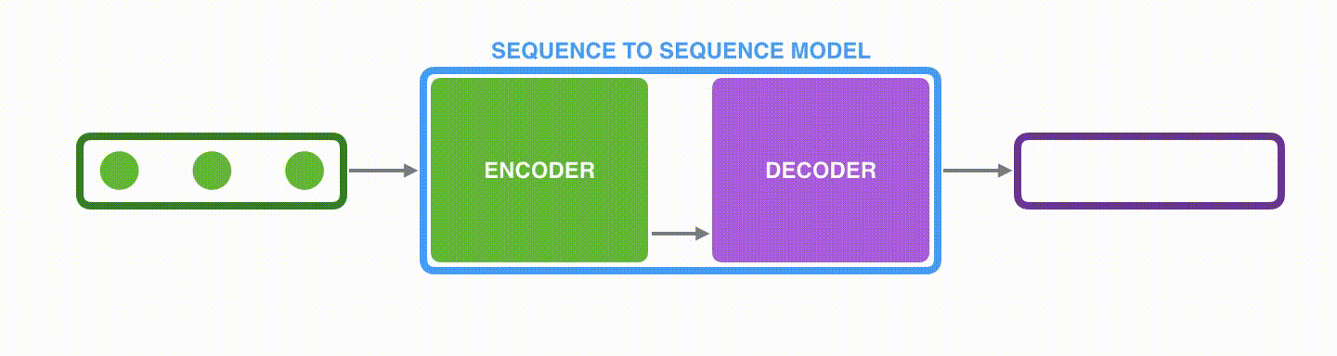
Sequence to sequence models
Under the hood, the model is composed of an encoder and a decoder. The encoder processes each item in the input sequence, it compiles the information it captures into a vector (called the context). After processing the entire input sequence, the encoder sends the context over to the decoder, which begins producing the output sequence item by item

Slide 14
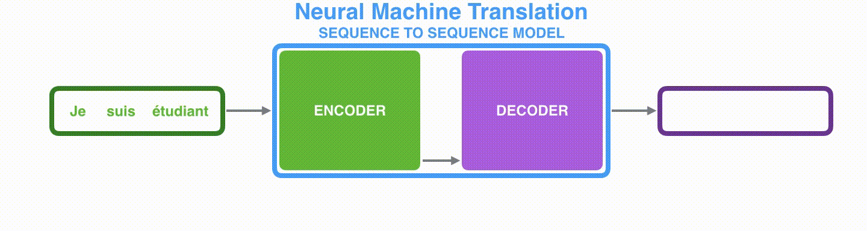
Sequence to sequence models

Slide 15
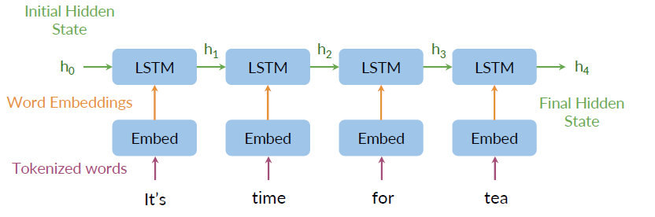
Sequence to sequence encoder

Slide 16
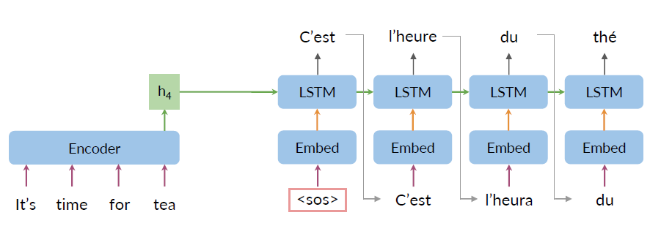
Sequence to sequence decoder

Slide 17
Seq2Seq bottlenecks
Loss of information
No parallel computing
Vanishing gradient

Slide 18
Attention mechanism

Slide 19
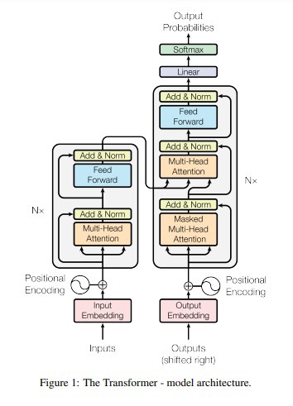
Attention is all you need

Slide 20
Attention is all you need
An attention function can be described as mapping a query and a set of key-value pairs to an output, where the query, keys, values, and output are all vectors.
The output is computed as a weighted sum of the values, where the weight assigned to each value is computed by a compatibility function of the query with the corresponding key.

Slide 21
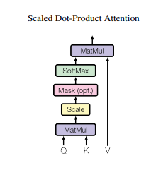
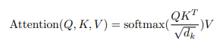
Attention is all you need

Slide 22
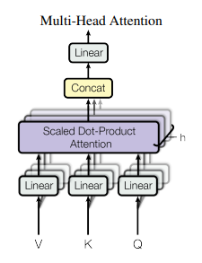
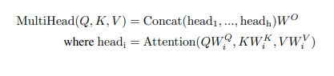
Attention is all you need
Multi-head attention allows the model to jointly attend to information from different representation subspaces at different positions. With a single attention head, averaging inhibits this.

Slide 23
BERT

Slide 24
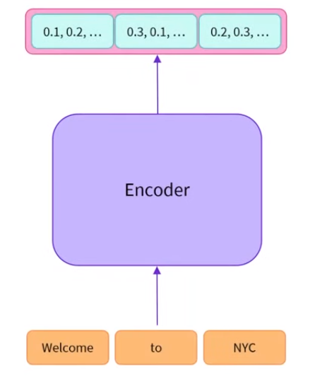
BERT
A bidirectional transformer pre-trained using a combination of masked language modeling objective and next sentence prediction on a large corpus comprising the Toronto Book Corpus and Wikipedia

Slide 25
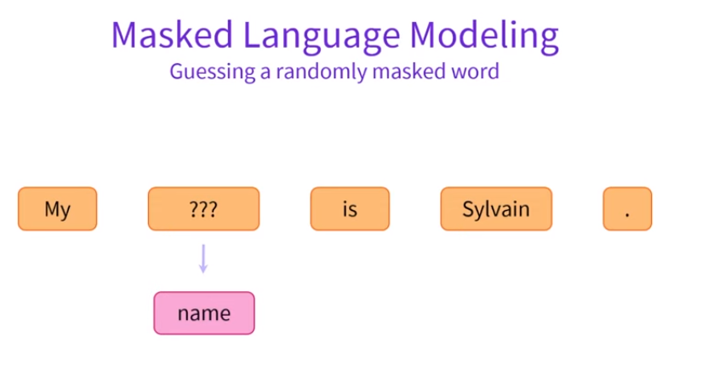
BERT

Slide 26
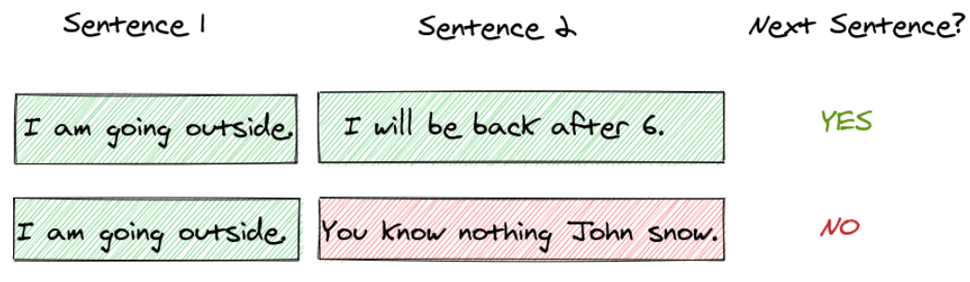
BERT
Next Sentence Prediction

Slide 27
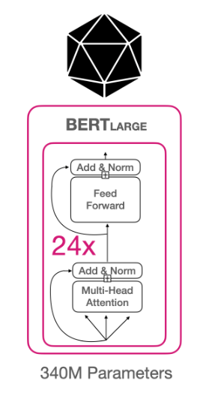
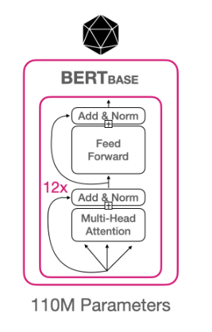
BERT Architecture

Slide 28
BERT Architecture

Slide 29
GPT

Slide 30
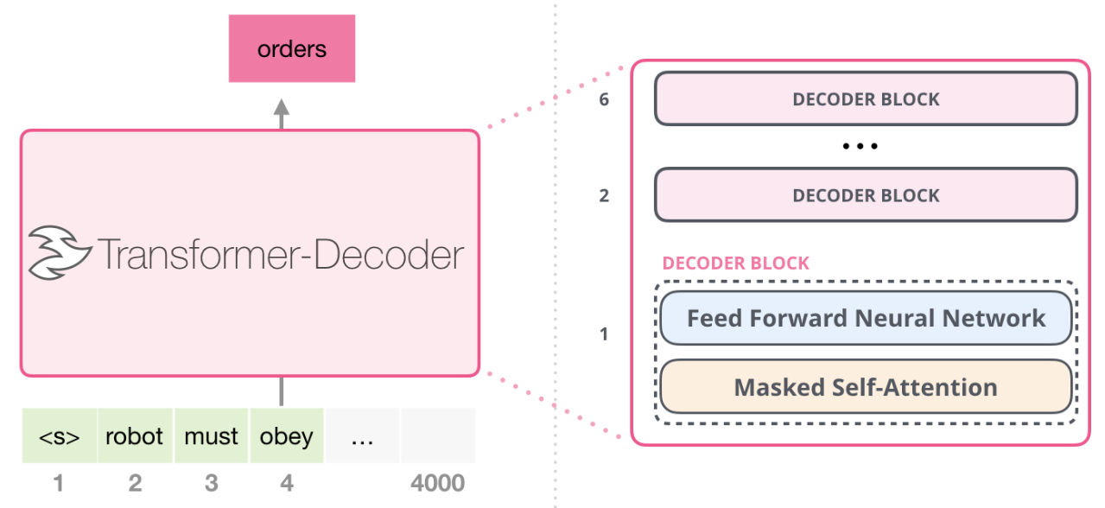
GPT2
GPT is a language model with transformer based architecture that is trained to take input text and transform it into what it predicts the most useful result will be

Slide 31
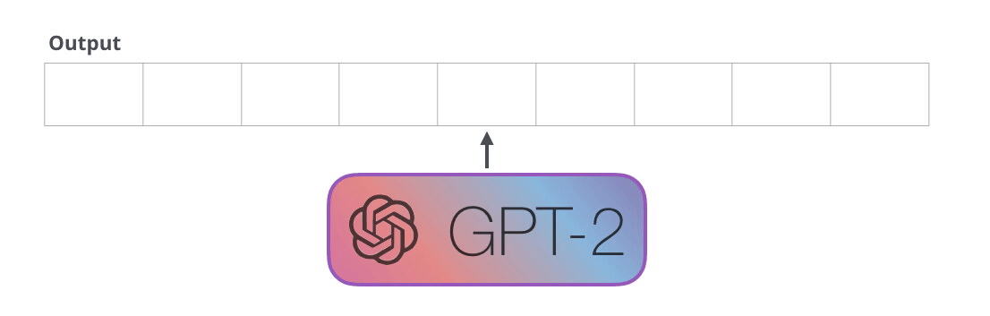
GPT2
GPT-2 is built using transformer decoder blocks
Like traditional language models GPT-2 outputs one token at a time

Slide 32

GPT2
Imagine GPT-2 as a storyteller who is telling a bed time story to a kid
This storyteller's job now needs to be creative, so he starts with an initial plot line and writes one word at a time.
The storyteller starts with the first word. They carefully select it, considering the story's introduction and the tone they want to set
They remember everything they've written so far in the story, as well as the context of the current scene. This memory allows them to ensure that the story flows logically.

Slide 33
GPT2
Once they've written the first word, it's time for the second word. Here's where autoregression comes in
The storyteller decides the next word in the story based on the context provided by the previous words. It's like they're predicting the next word in the story to make sure it makes sense and keeps the narrative cohesive
The storyteller continues this process, word by word, predicting and writing the next word based on what they've written before
They ensure that the sentences flow smoothly and that the story remains engaging.
This process of autoregression continues until the storyteller decides to stop. The story can be as short or as long as needed, and the storyteller maintains the coherence and consistency throughout

Slide 34
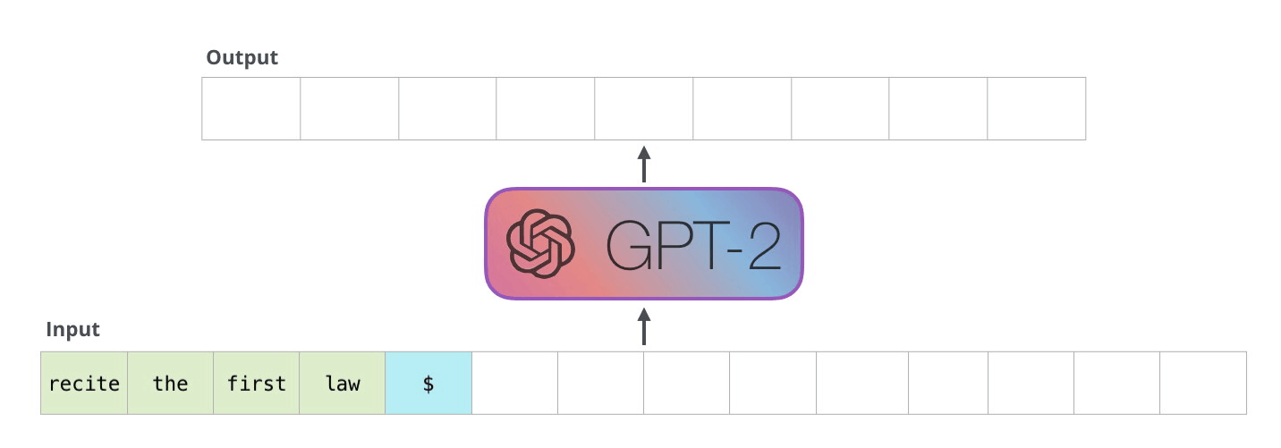
GPT2

Slide 35
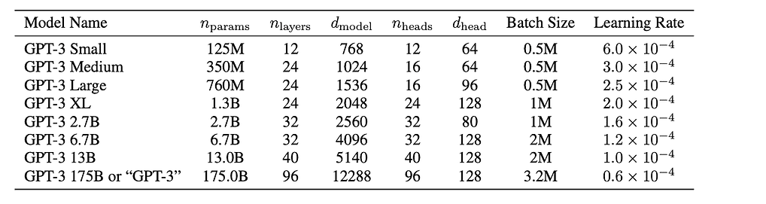
GPT2 Architecture
GPT is a language model with transformer based architecture that is trained to take input text and transform it into what it predicts the most useful result will be

Slide 36
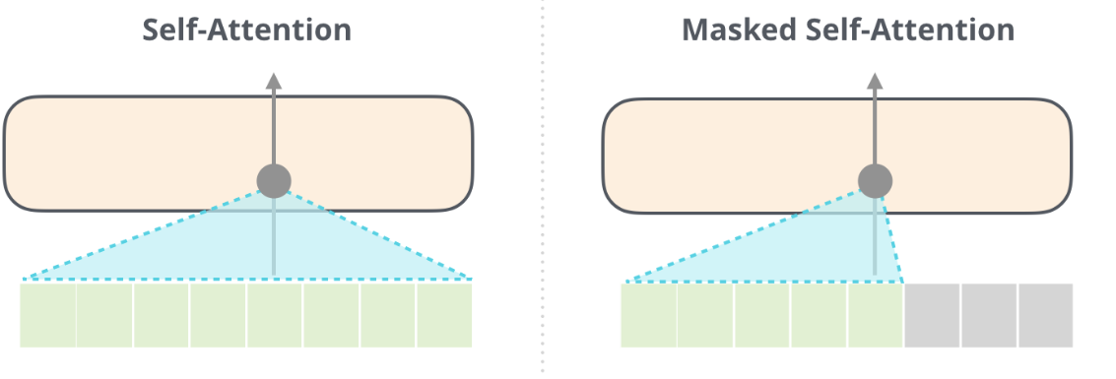
GPT Architecture
A normal self-attention block allows a position to peak at tokens to its right
Masked self-attention prevents peaking at tokens at the right

Slide 37
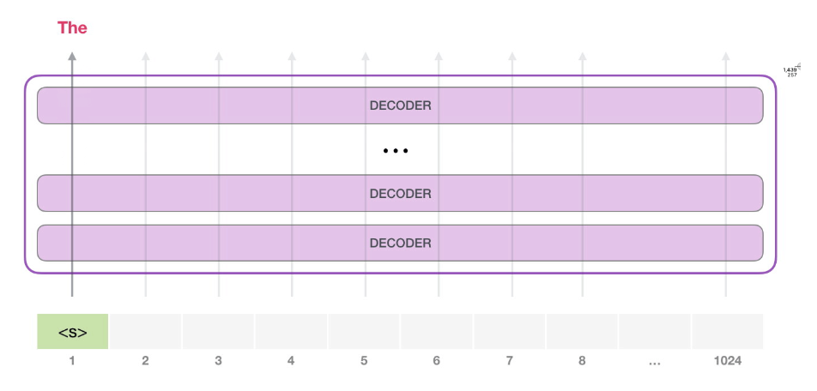
GPT2 Architecture
The model only has one input token, so that path would be the only active one
The token is processed successively through all the layers, then a vector is produced along that path
The vector can be stored against model vocabulary (50K words for GPT2)
In this case we selected the token with the highest probability, ‘the’.

Slide 38
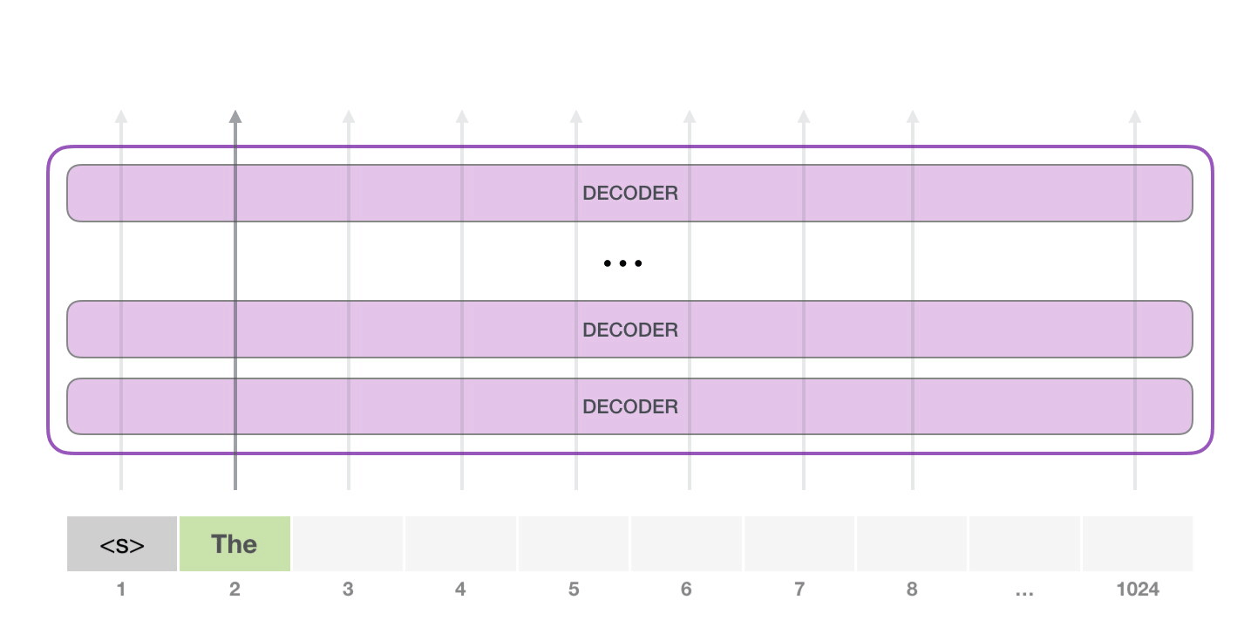
GPT2 Architecture
However, there is a catch!
If we keep on looking for the highest probability work, we might get stuck in a loop of repetitive words
The same can happen here. GPT-2 has a parameter called top-k that we can use to have the model consider sampling words other than the top word (which is the case when top-k = 1)

Slide 39
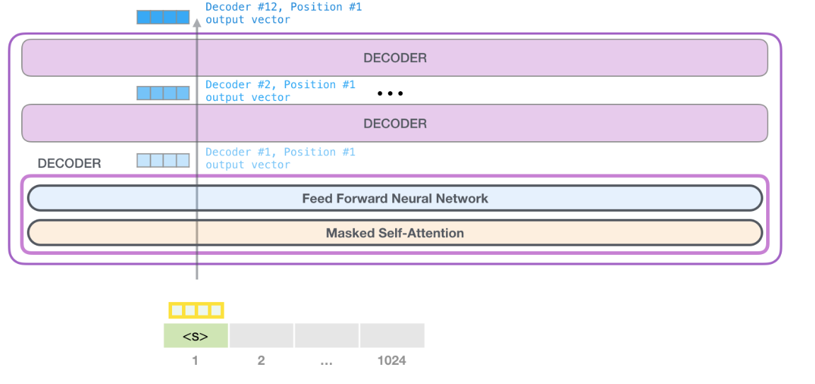
GPT Architecture

Slide 40
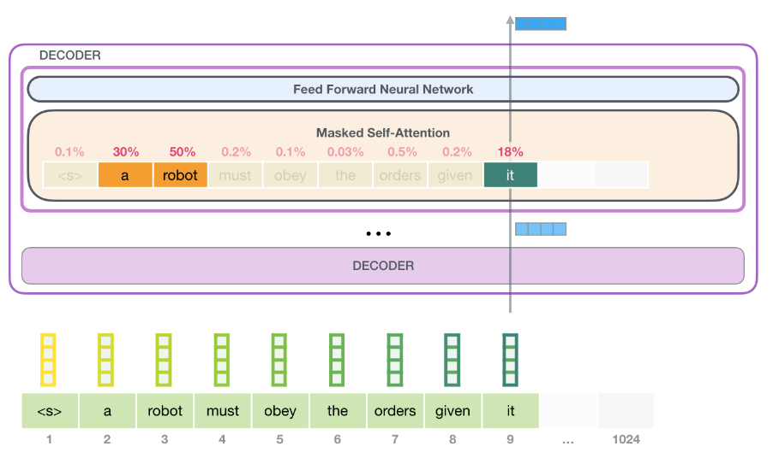
GPT Architecture

Slide 41
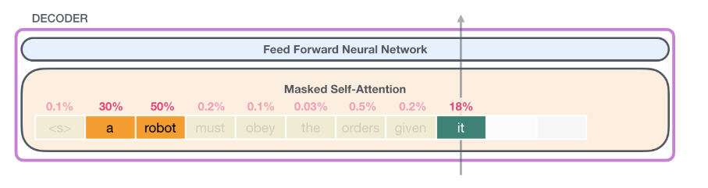
GPT Self attention

